Slide 1
Axial and Appendicular Skeleton

Slide 2
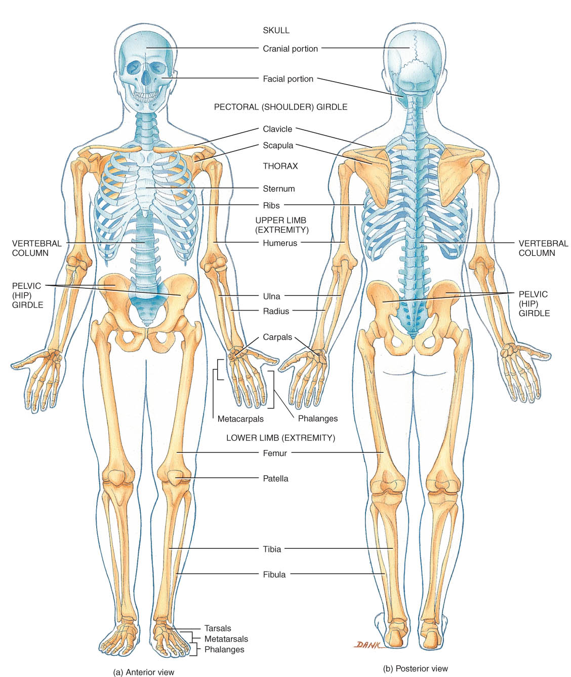
The Skeletal System: The Axial Skeleton
Axial Skeleton
80 bones
skull, hyoid, vertebrae, ribs, sternum, ear ossicles
Appendicular Skeleton
126 bones
upper & lower limbs and pelvic & pectoral girdles

Slide 3
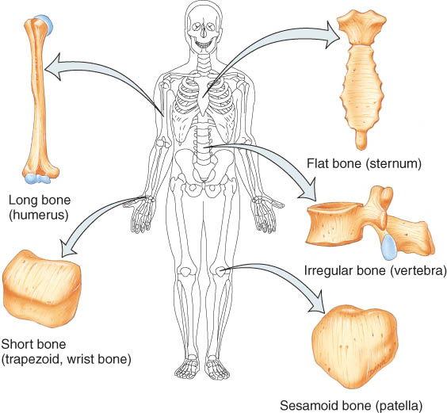
Types of Bones
5 basic types of bones:
long
short
flat
irregular
sesamoid (patella)
Sutural bones = in joint between skull bones

Slide 4
BONE SURFACE MARKINGS
There are two major types of surface markings.
Depressions and openings participate in joints or allow the passage of soft tissue.
Processes are projections or outgrowths that either help form joints or serve as attachment points for connective tissue.

Slide 5
Bone Surface Markings
Foramen = opening or hole
Fossa = shallow depression
Sulcus = groove
Meatus = tubelike passageway or canal
Condyle = large, round protuberance
Facet = smooth flat articular surface
Trochanter = very large projection
Tuberosity = large, rounded, roughened projection

Slide 6
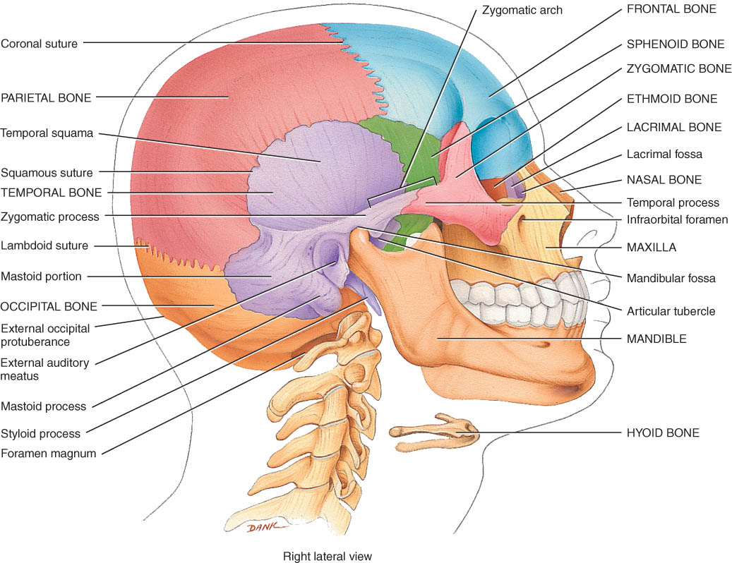
The Skull
8 Cranial bones
protect brain & house ear ossicles
muscle attachment for jaw, neck & facial muscles
14 Facial bones
protect delicate sense organs -- smell, taste, vision
support entrances to digestive and respiratory systems

Slide 7
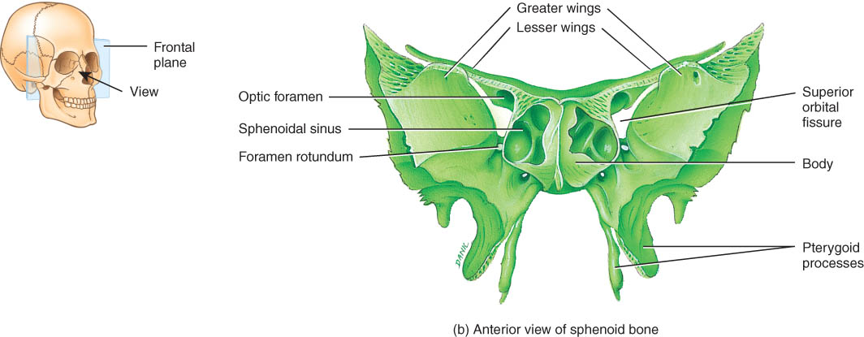
Sphenoid in Anterior View
Body is a cubelike portion holding sphenoid sinuses
Greater and lesser wings

Slide 8
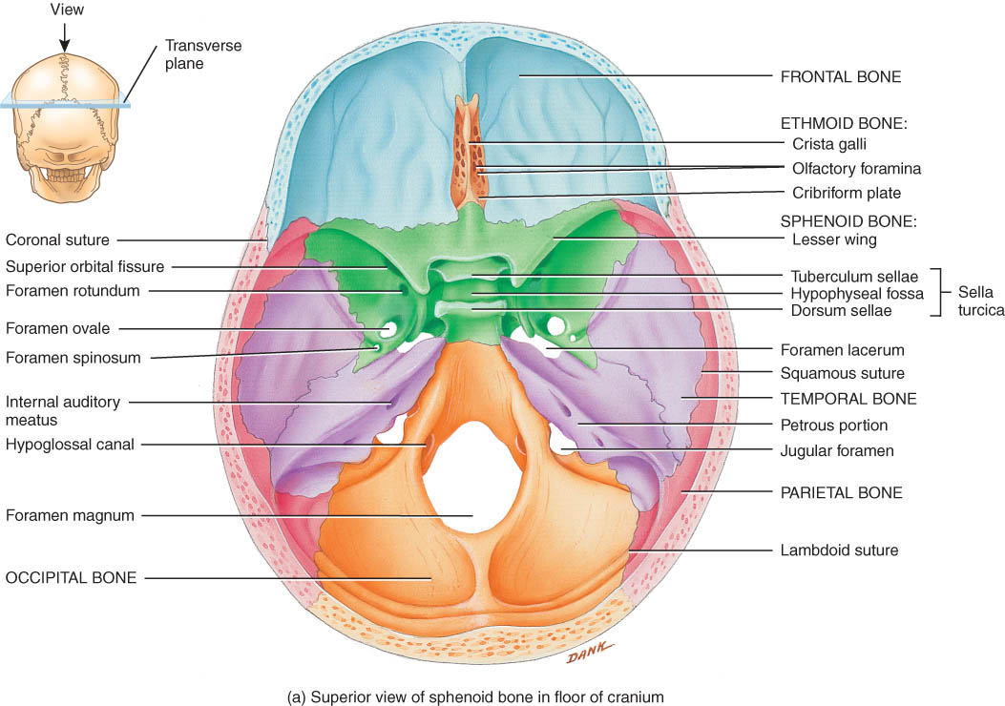
Sphenoid from Superior View
Lesser wing & greater wing
Sella turcica holds pituitary gland

Slide 9
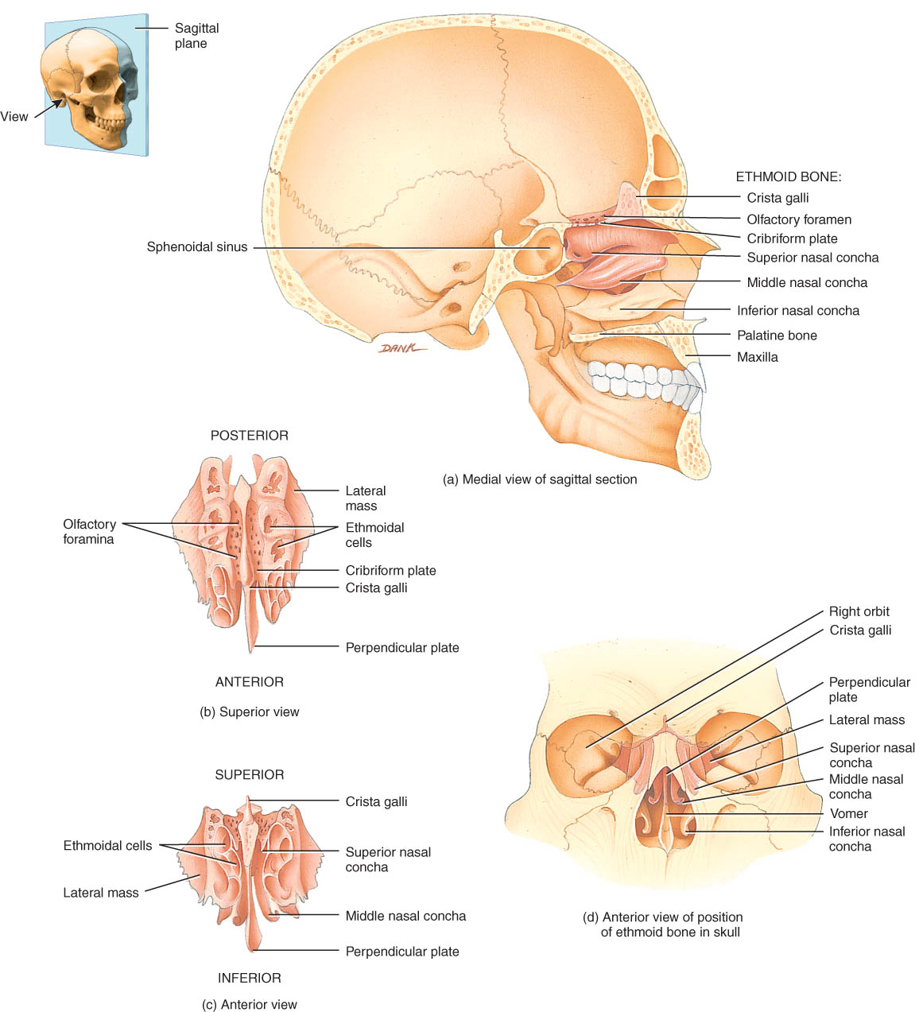
Ethmoid bone
Lateral masses contain ethmoid sinuses
Perpendicular plate is upper part of nasal septum
Superior & middle nasal concha or turbinates
filters & warms air

Slide 10
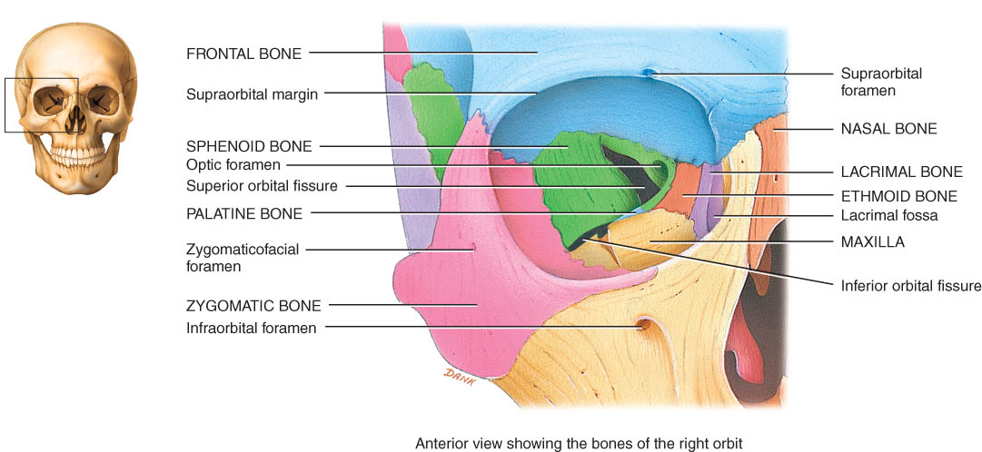
Bones of the Orbit
Roof is frontal and sphenoid
Lateral wall is zygomatic and sphenoid
Floor is maxilla, zygomatic, palatine and sphenoid
Medial wall is maxilla, lacrimal, ethmoid and sphenoid
Orbital fissures and optic foramen

Slide 11
Unique Features of the Skull
Sutures
Sinuses
Fontanels

Slide 12
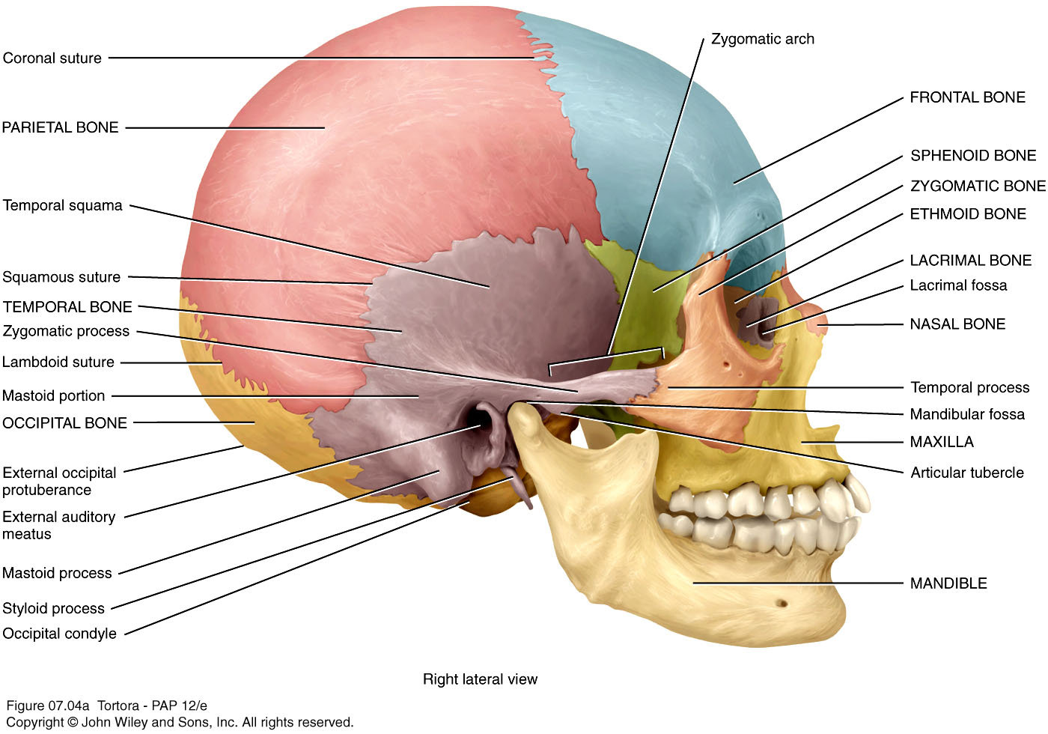
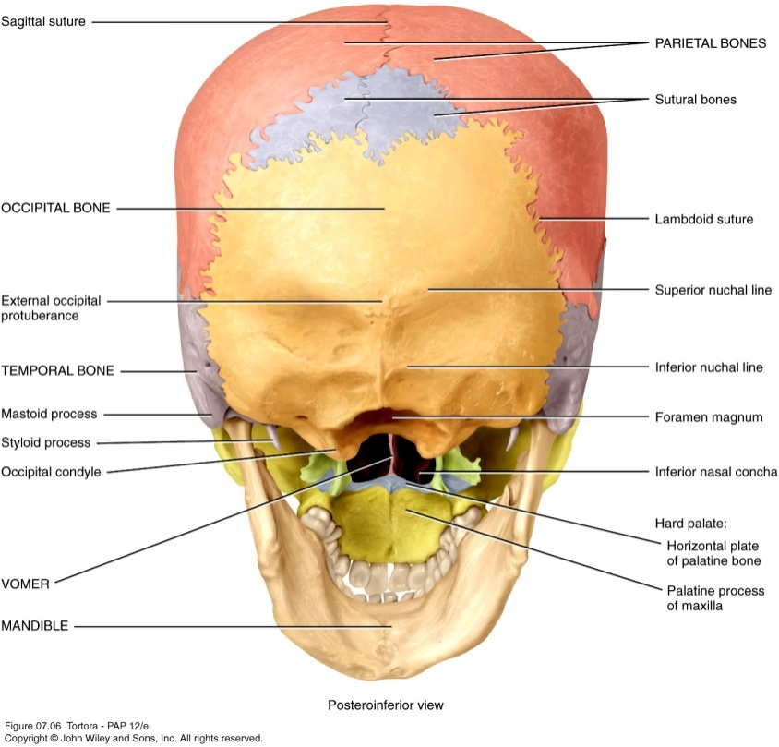
Sutures
Sutures are immovable joints found only between skull bones and hold skull bones together.
Sutures include the coronal, sagittal, lamboidal,and squamous sutures, among others

Slide 13
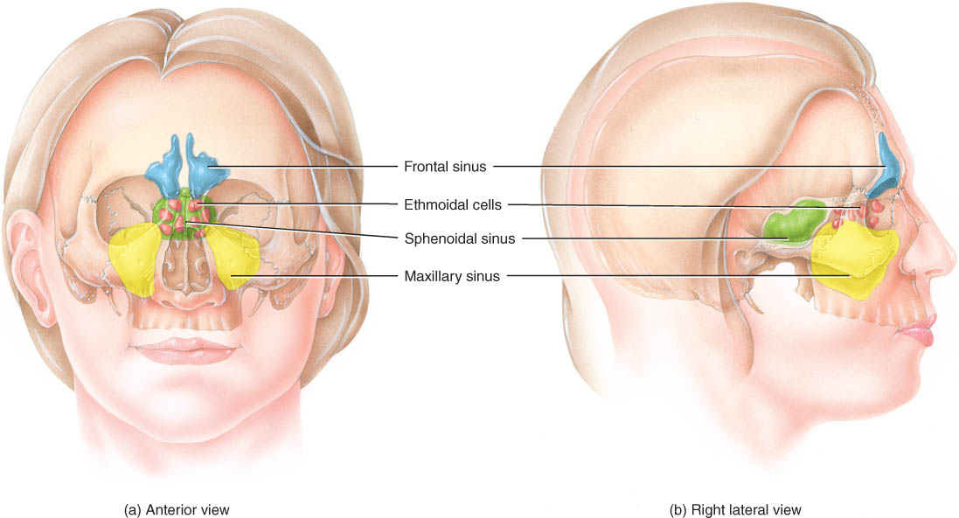
Paranasal Sinuses
Paired cavities in ethmoid, sphenoid, frontal and maxillary
Lined with mucous membranes and open into nasal cavity
Resonating chambers for voice, lighten the skull
Sinusitis is inflammation of the membrane (allergy)

Slide 14
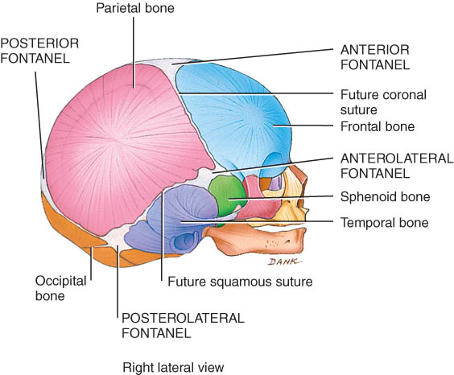
Fontanels of the Skull at Birth.
Dense connective tissue membrane-filled spaces (soft spots)
Unossified at birth but close early in a child's life.

Slide 15
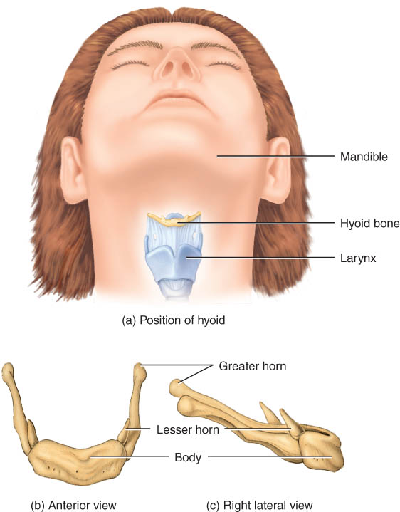
Hyoid Bone
U-shaped single bone
Articulates with no other bone of the body
Suspended by ligament and muscle from skull
Supports the tongue & provides attachment for tongue, neck and pharyngeal muscles

Slide 16
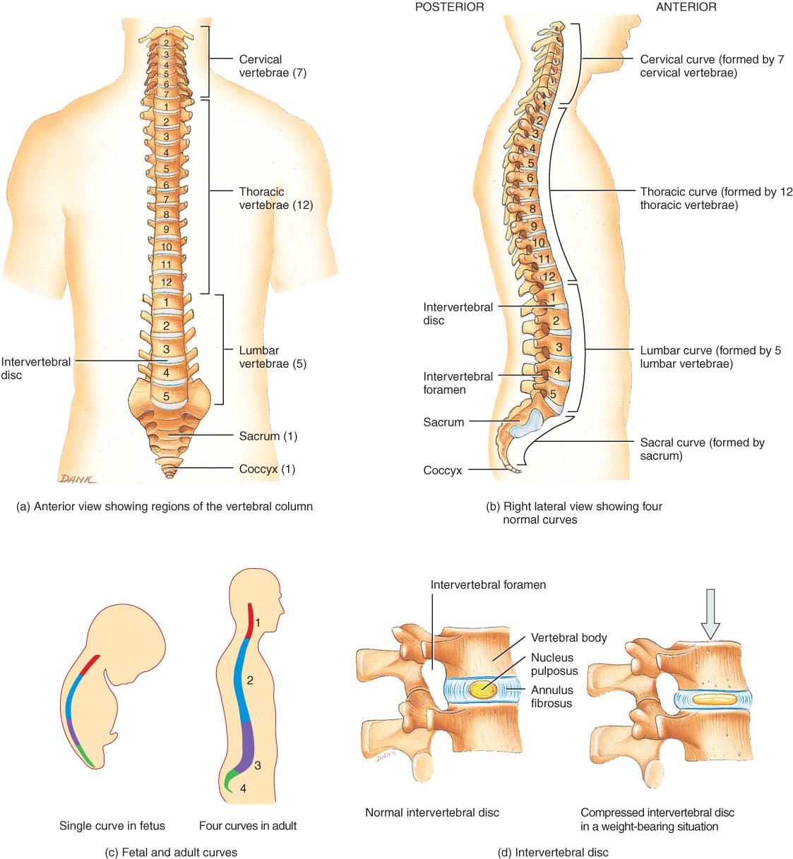
Vertebral Column
Backbone or spine built of 26 vertebrae
Five vertebral regions
cervical vertebrae (7) in the neck
thoracic vertebrae ( 12 ) in the thorax
lumbar vertebrae ( 5 ) in the low back region
sacrum (5, fused)
coccyx (3-5, fused)

Slide 17
Intervertebral Discs
Between adjacent vertebrae absorbs vertical shock
Fibrocartilagenous ring with a pulpy center

Slide 18
Normal Curves of the Vertebral Column
Primary curves
thoracic and sacral are formed during fetal development
Secondary curves
cervical is formed when infant raises head at 4 months
lumbar forms when infant sits up & begins to walk at 1 year

Slide 19
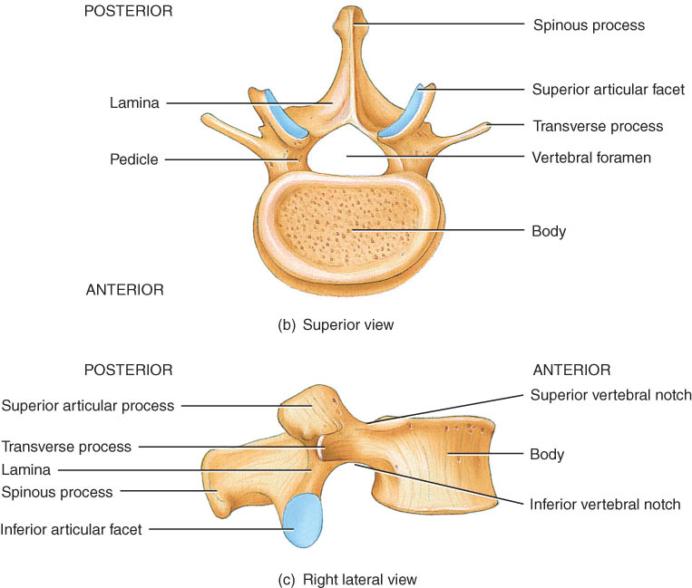
Typical Vertebrae
Body
weight bearing
Pedicle
Lamina
Vertebral foramen
Seven processes
2 transverse
1 spinous
4 articular
2 superior
2 inferior
Vertebral notches

Slide 20
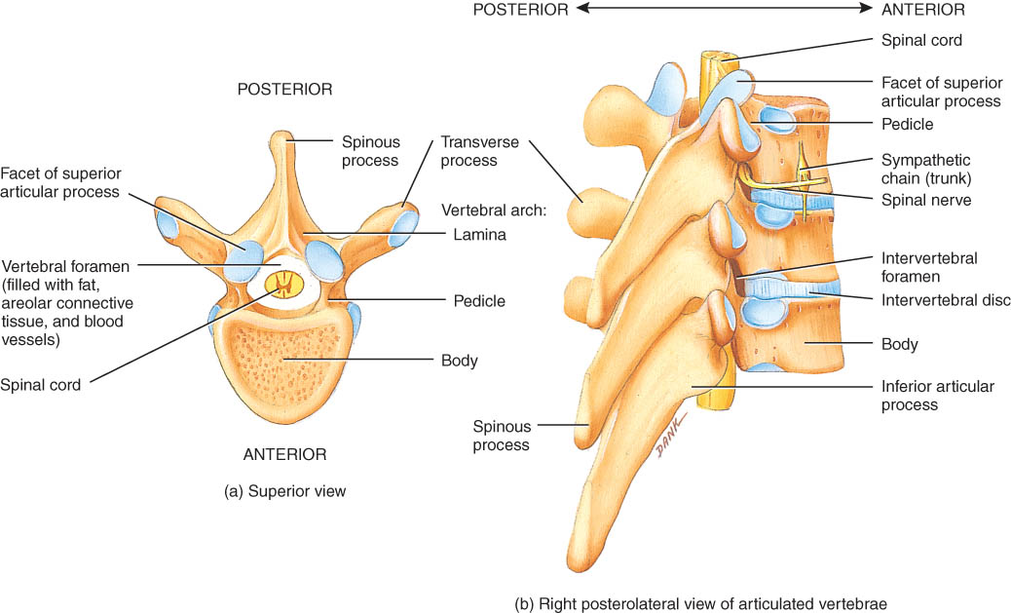
Intervertebral Foramen & Spinal Canal
Spinal canal is all vertebral foramen together
Intervertebral foramen are 2 vertebral notches together

Slide 21
Regions of the Vertebral Column
Cervical
Thoracic
Lumbar
Sacral
Coccygeal

Slide 22
Cervical Vertebra
There are 7 cervical vertebrae.
The first cervical vertebra is the atlas and supports the skull.
The second cervical vertebra is the axis, which permits side-to-side rotation of the head.
The third to sixth correspond to the structural patterns of the typical cervical vertebrae.
The seventh called the vertebra prominens is somewhat different

Slide 23
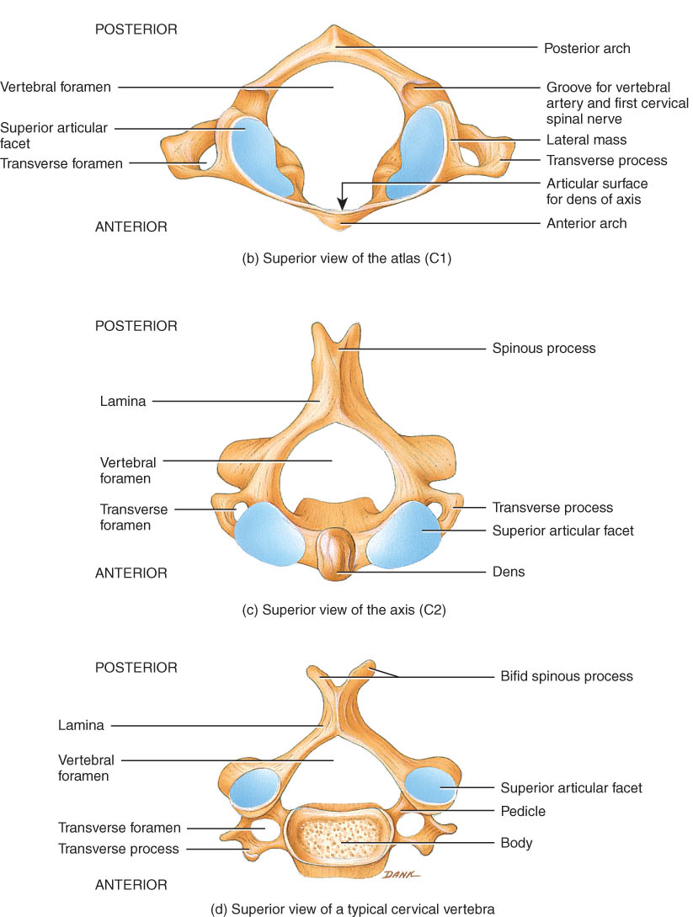
Atlas & Axis (C1-C2)
Atlas -- ring of bone, superior facets for occipital condyles
nodding movement at atlanto-occipital joint signifies “yes”
Axis -- dens or odontoid process is body of atlas
pivotal movement at atlanto-axial joint signifies “no”

Slide 24
Typical Cervical Vertebrae (C3-C7)
Smaller bodies but larger spinal canal
Transverse processes
shorter, with transverse foramen for vertebral artery
Spinous processes of C2 to C6 often bifid

Slide 25
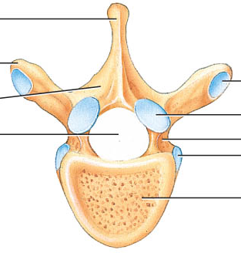
Thoracic Vertebrae (T1-T12)
Larger and stronger bodies
Longer transverse & spinous processes
Facets or demifacets on body for head of rib
Facets on transverse processes (T1-T10) for tubercle of rib

Slide 26
Lumbar Vertebrae
Strongest & largest
Short thick spinous & transverse processes
back musculature

Slide 27
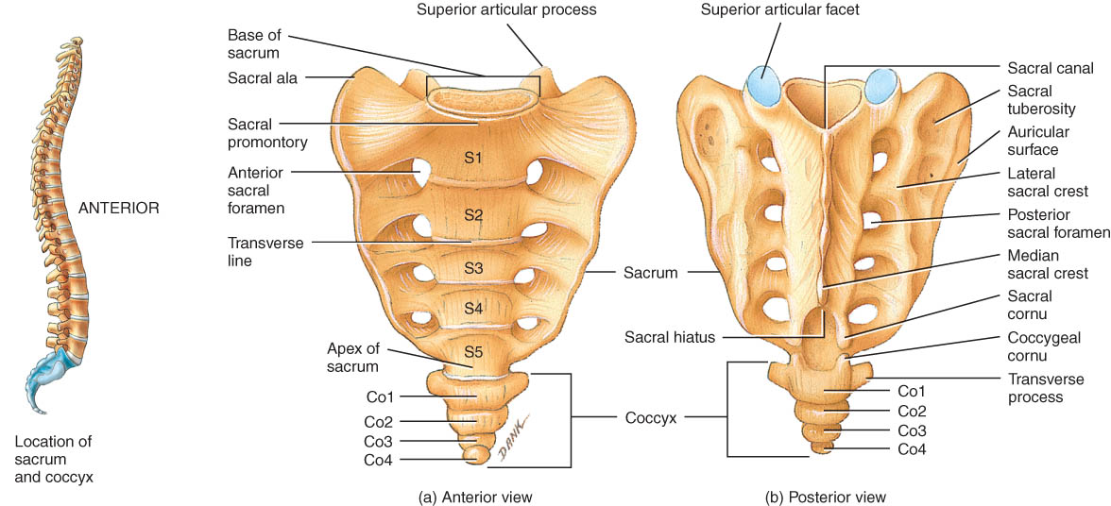
Sacrum
Union of 5 vertebrae (S1 - S5) by age 30
median sacral crest was spinous processes
sacral ala (aye-la) is fused transverse processes
Sacral canal ends at sacral hiatus

Slide 28
Coccyx
Union of 3-5 vertebrae (Co1 - Co4) by age 30

Slide 29
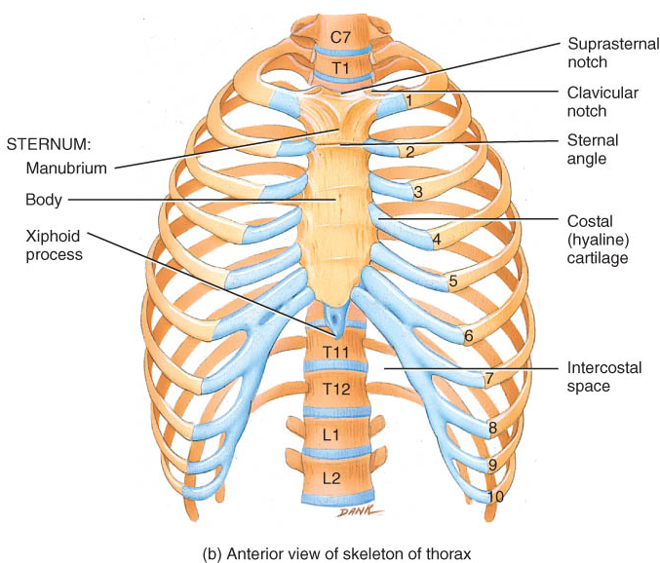
Thorax
Bony cage flattened from front to back
Sternum (breastbone)
Ribs
1-7 are true ribs (vertebrosternal)
8-10 are false ribs (vertebrochondral)
11-12 are floating (vertebral)
Costal cartilages
Bodies of the thoracic vertebrae.

Slide 30
Sternum
Manubrium
1st & 2nd ribs
clavicular notch
Body
costal cartilages of 2-10 ribs
Xiphoid
ossifies by 40
CPR position
abdominal muscles
Sternal puncture
biopsy

Slide 31
Appendicular Skeleton

Slide 32
INTRODUCTION
The appendicular skeleton includes the bones of the upper and lower extremities and the shoulder and hip girdles.
The appendicular skeleton functions primarily to facilitate movement.

Slide 33
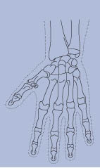
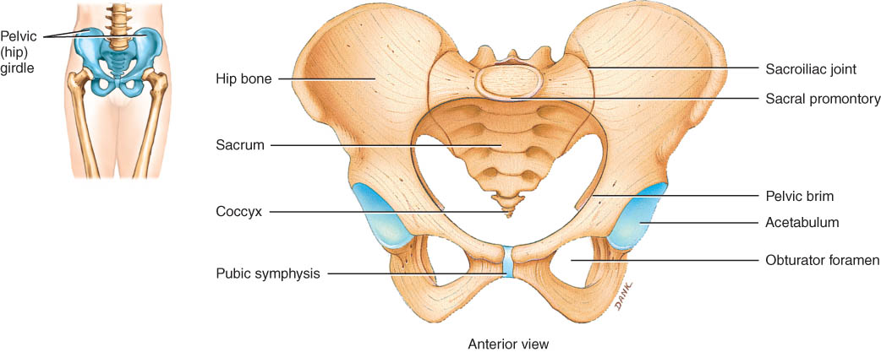
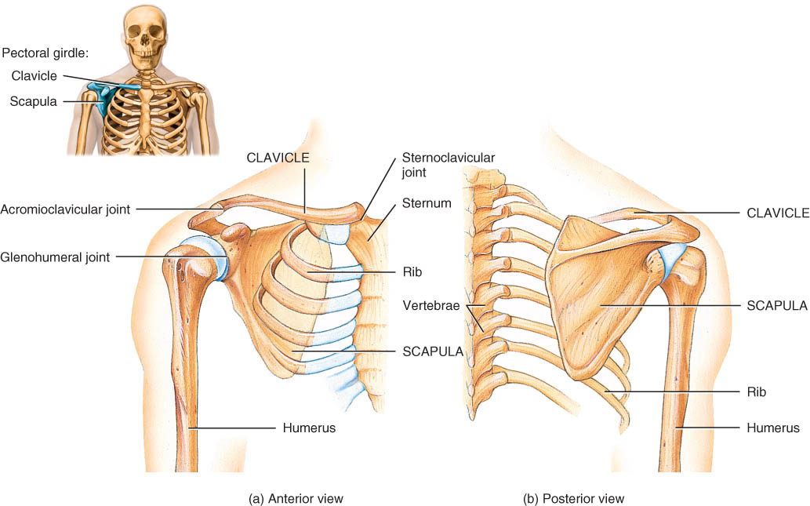
Appendicular Skeleton
Four parts
Pectoral girdle
Pelvic girdle
Upper limbs
Lower limbs

Slide 34
Pectoral (Shoulder) Girdle
The pectoral or shoulder girdle attaches the bones of the upper limbs to the axial skeleton.
Consists of scapula and clavicle
Scapula held in place by muscle only
Upper limb attached to pectoral girdle at shoulder (glenohumeral joint)

Slide 35
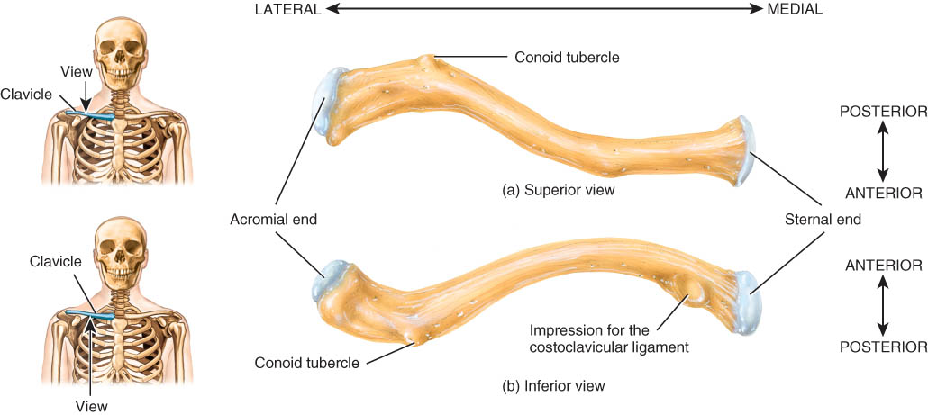
Clavicle (collarbone)
S-shaped bone with two curves
Extends from sternum to scapula above 1st rib
Fracture site is junction of curves

Slide 36
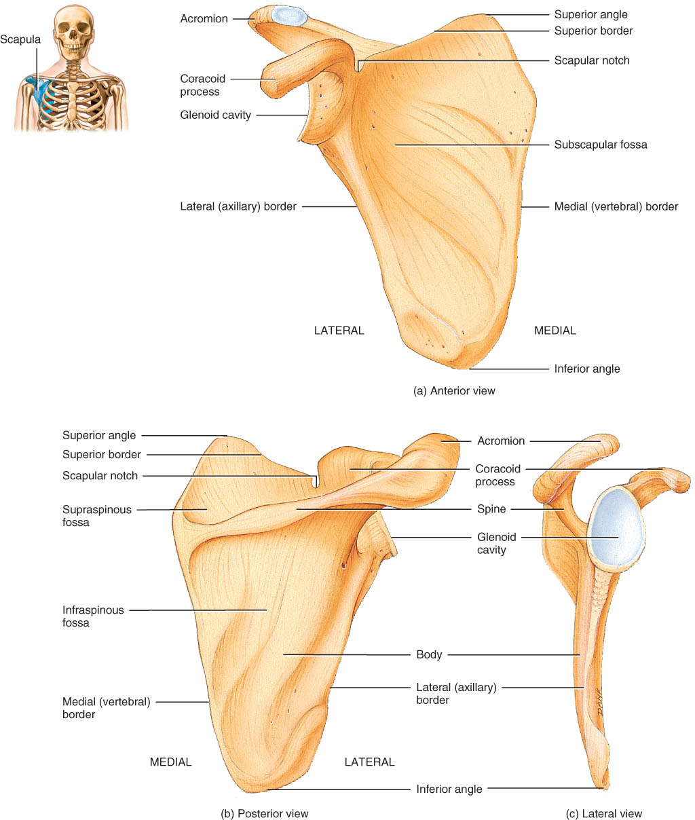
Anterior Surface of Scapula
Subscapular fossa filled with muscle
Coracoid process for muscle attachment

Slide 37
Posterior Surface of Scapula
Triangular flat bone found in upper back region
Glenoid cavity forms shoulder joint with head of humerus
Supraspinous & infraspinous fossa for muscular attachments

Slide 38
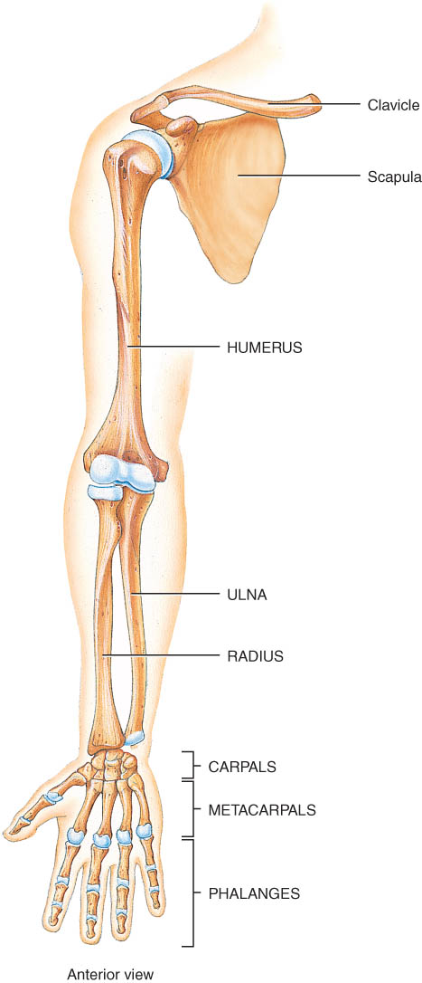
Upper Extremity
Each upper limb = 30 bones
humerus within the arm
ulna & radius within the forearm
carpal bones within the wrist (8)
metacarpal bones within the palm
phalanges in the fingers (14)
Joints
shoulder (glenohumeral), elbow, wrist, metacarpophalangeal, interphalangeal

Slide 39
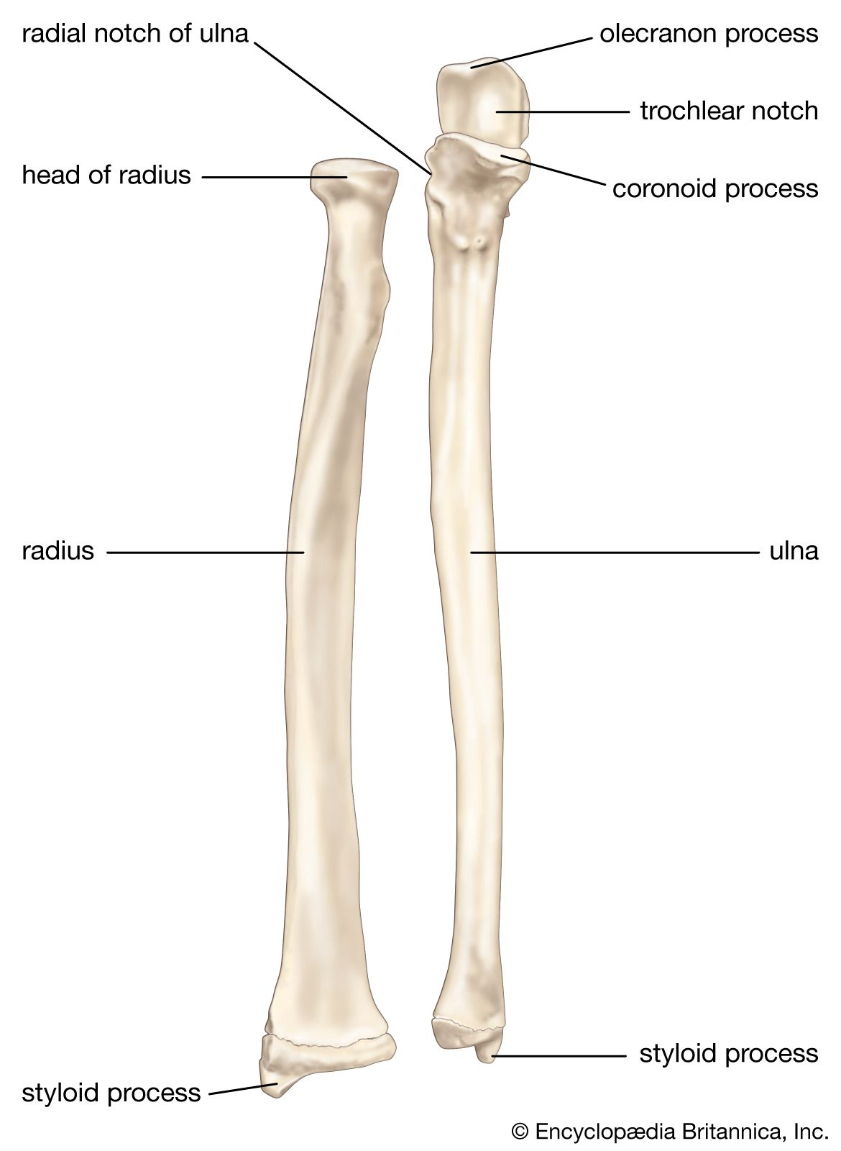
Ulna & Radius
Ulna (on little finger side)
trochlear notch articulates with humerus & radial notch with radius
olecranon process forms point of elbow
Radius (on thumb side)
head articulates with capitulum of humerus & radial notch of ulna
tuberosity for muscle attachment

Slide 40
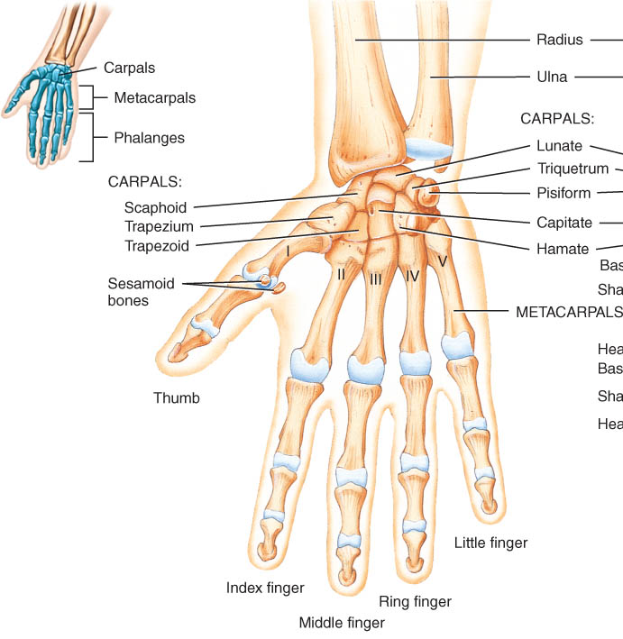
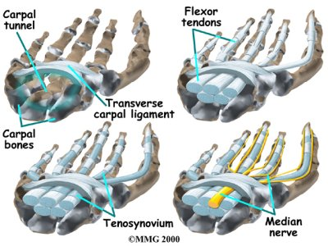
8 Carpal Bones (wrist)
Proximal row - lat to med
scaphoid - boat shaped
lunate - moon shaped
triquetrum - 3 corners
pisiform - pea shaped
Distal row - lateral to medial
trapezium - four sided
trapezoid - four sided
capitate - large head
hamate - hooked process
Carpal tunnel--tunnel of bone & flexor retinaculum
Stop Letting Those People Touch The Cadaver’s Hand.
Scaphoid, Lunate, Triquetrum, Pisiform, Trapezium, Trapezoid, Capitate, Hamate

Slide 41
Pelvic Girdle and Hip Bones
Pelvic girdle = two hipbones united at pubic symphysis
articulate posteriorly with sacrum at sacroiliac joints
Each hip bone = ilium, pubis, and ischium
fuse after birth at acetabulum
Bony pelvis = 2 hip bones, sacrum and coccyx

Slide 42
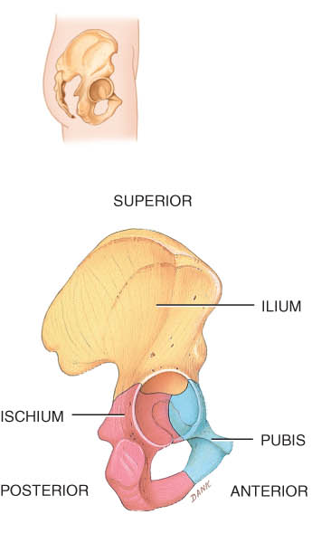
Pelvic bones

Slide 43
Female and Male Skeletons
Male skeleton
larger and heavier
larger articular surfaces
larger muscle attachments
Female pelvis
wider & shallower
larger pelvic inlet & outlet
pubic arch >90 degrees

Slide 44
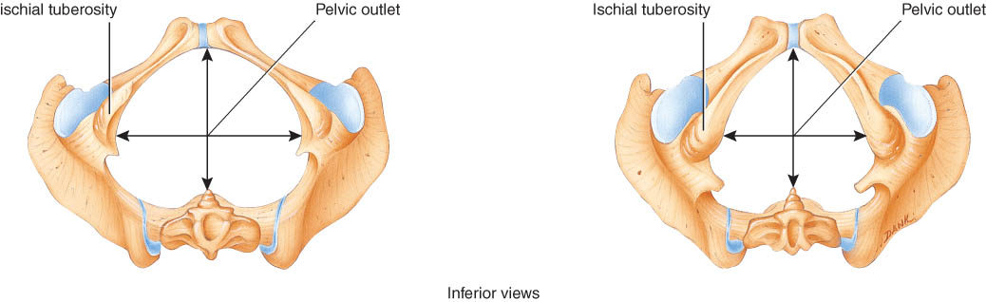
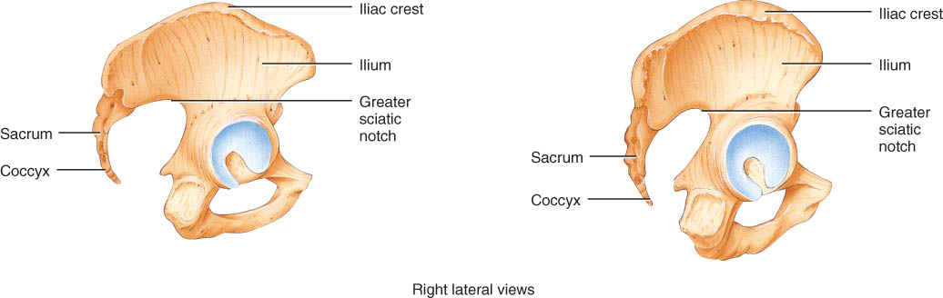
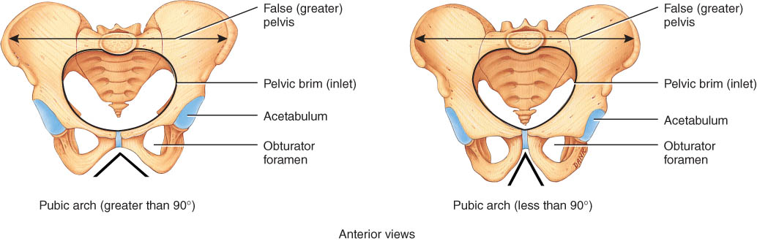
Female Male

Slide 45
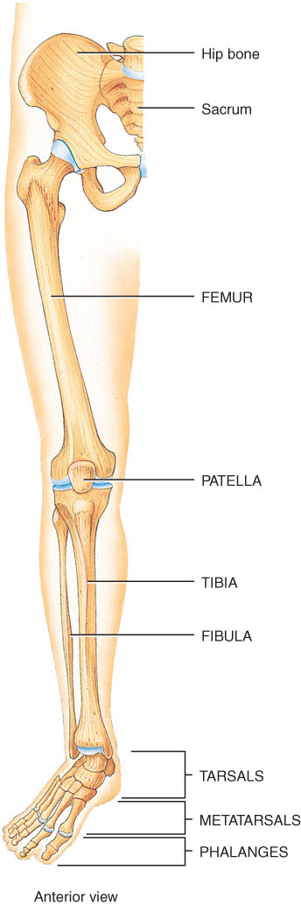
Lower Extremity
Each lower limb = 30 bones
femur and patella within the thigh
tibia & fibula within the leg
tarsal bones in the foot
metatarsals within the forefoot
phalanges in the toes
Joints
hip, knee, ankle
proximal & distal tibiofibular
metatarsophalangeal

Slide 46
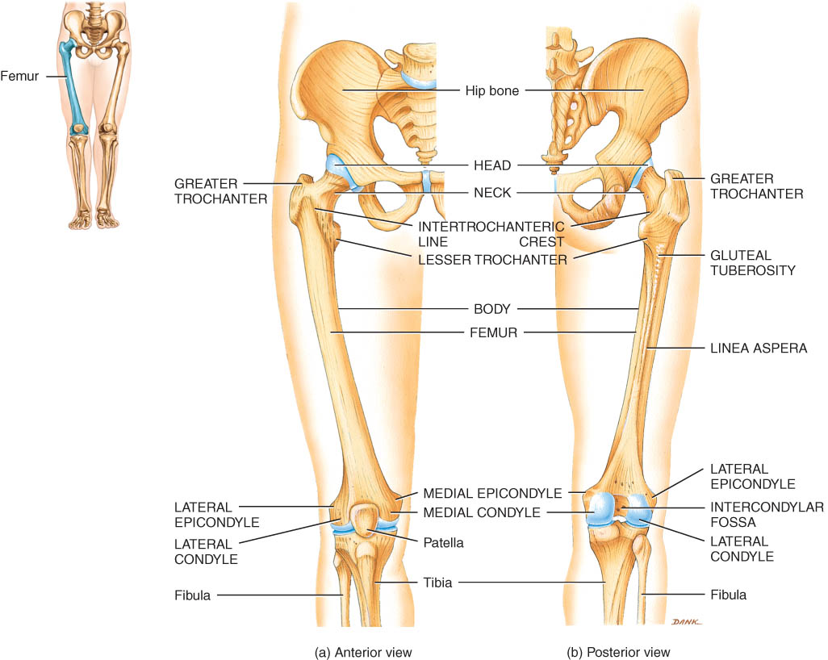
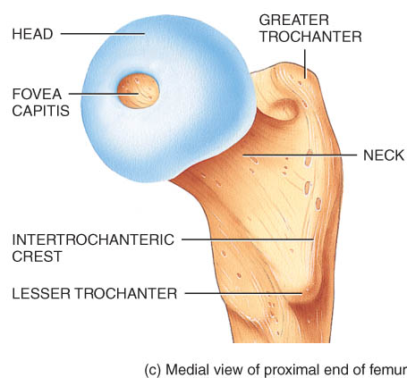
Femur

Slide 47
Patella
The patella or kneecap is a sesamoid bone located anterior to the knee joint .
It functions to increase the leverage of the tendon of the quadriceps femoris muscle, to maintain the position of the tendon when the knee is bent, and to protect the knee joint.

Slide 48
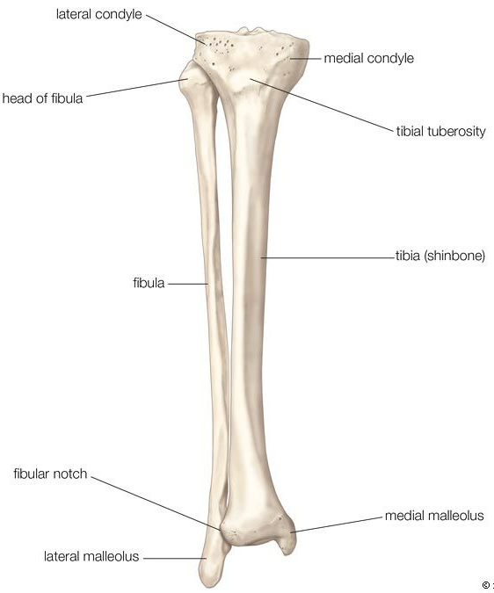
Tibia and Fibula
Tibia
Weight bearing bone
Fibula
not part of knee joint
muscle attachment only

Slide 49
Tarsals, Metatarsals, and Phalanges
Seven tarsal bones constitute the ankle and share the weight associated with walking
Five metatarsal bones are contained in the foot
Fractures of the metatarsals are common among dancers, especially ballet dancers.
The arrangement of phalanges in the toes is the same as that described for the fingers and thumb above - fourteen bones in each foot

Slide 50
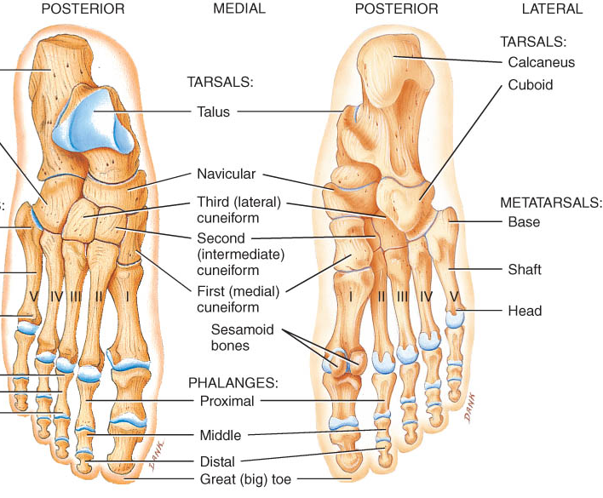
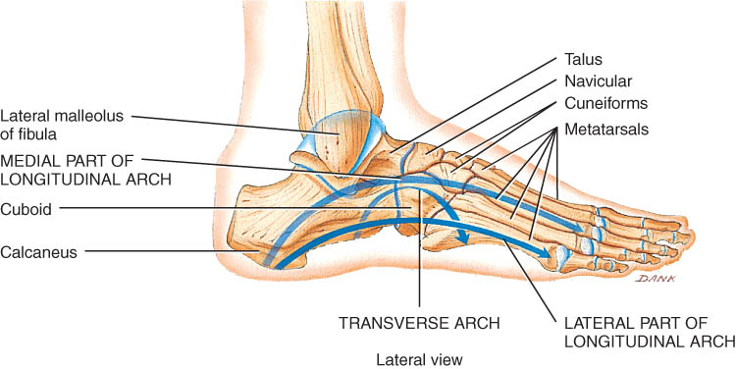
Tarsus
Proximal region of foot (contains 7 tarsal bones)
Talus = ankle bone (articulates with tibia & fibula)
Calcaneus - heel bone

Slide 51
Arches of the Foot
Function
distribute body weight over foot
yield & spring back when weight is lifted
Longitudinal arches along each side of foot
Transverse arch across midfoot region
navicular, cuneiforms & bases of metatarsals

